Slide 1
Projection
Course Code: CSC 3224
Course Title: Computer Graphics
Dept. of Computer Science
Faculty of Science and Technology
Lecturer No: |  | Week No: |  | Semester: | Fall 23-24
Lecturer: | Rahul Biswas, rbiswas@aiub.edu

Slide 2
Lecture Outline
Perspective Projection (Derivation)
Parallel Projection
Orthographic Parallel Projection (Derivation)
Oblique Parallel Projection (Derivation)

Slide 3
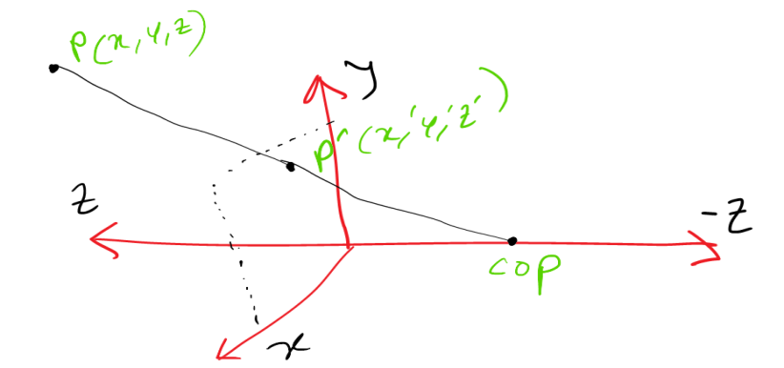
Parspective Projection
Point P Projected in XY Pane

Slide 4
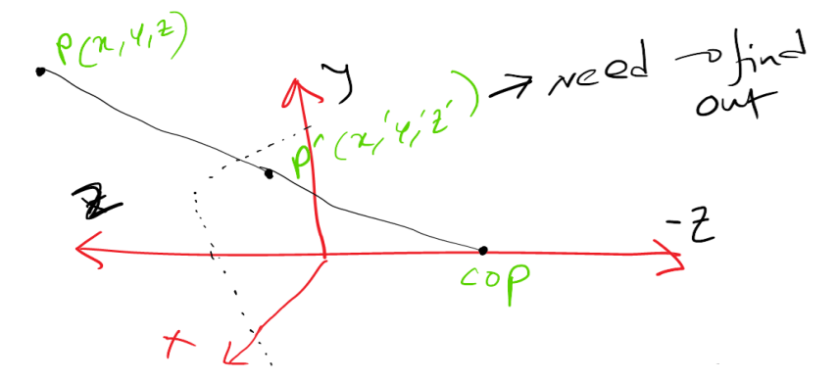
Parspective Projection
Need to Find out Xʹ, Yʹ

Slide 5
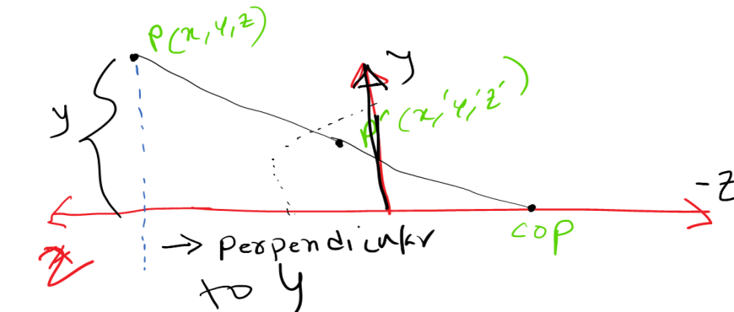
Parspective Projection
Need to Find out Xʹ, Yʹ

Slide 6
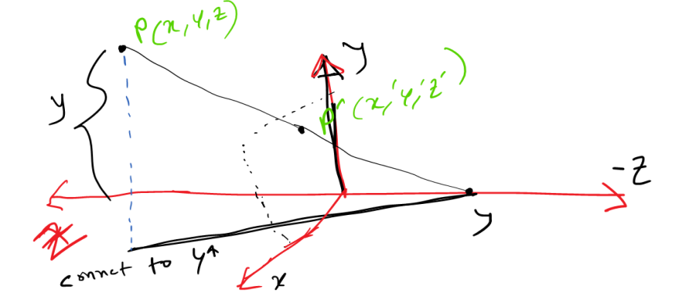
Parspective Projection
Need to Find out Xʹ, Yʹ

Slide 7
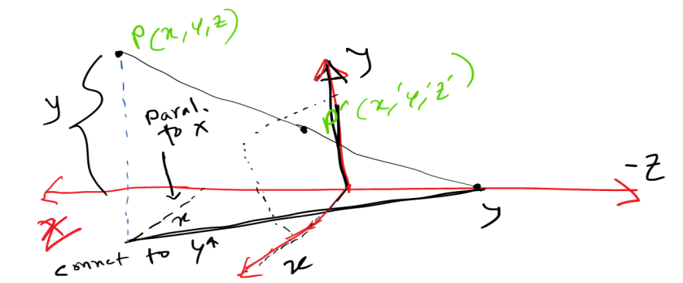
Parspective Projection
Need to Find out Xʹ, Yʹ

Slide 8
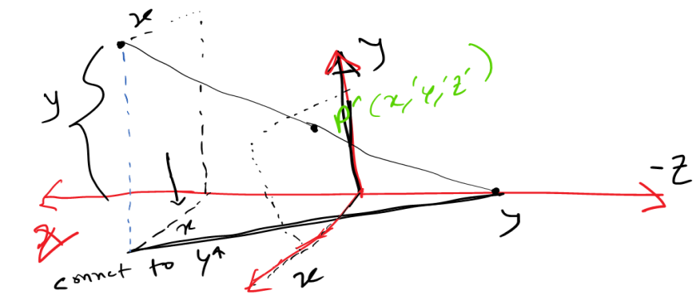
Parspective Projection
Need to Find out Xʹ, Yʹ

Slide 9
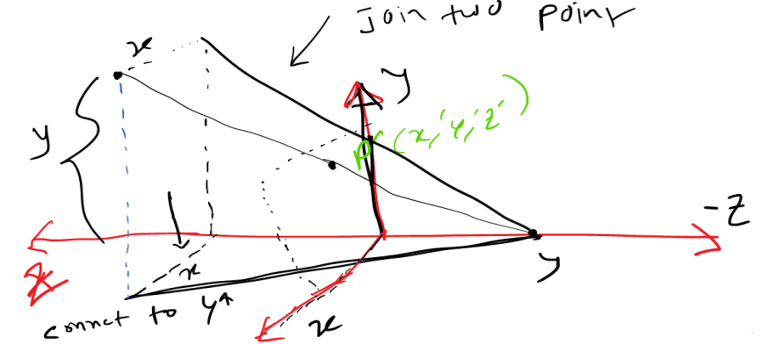
Parspective Projection
Need to Find out Xʹ, Yʹ

Slide 10
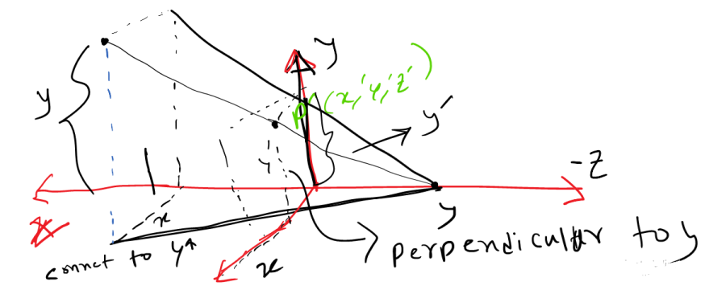
Parspective Projection
Need to Find out Xʹ, Yʹ

Slide 11
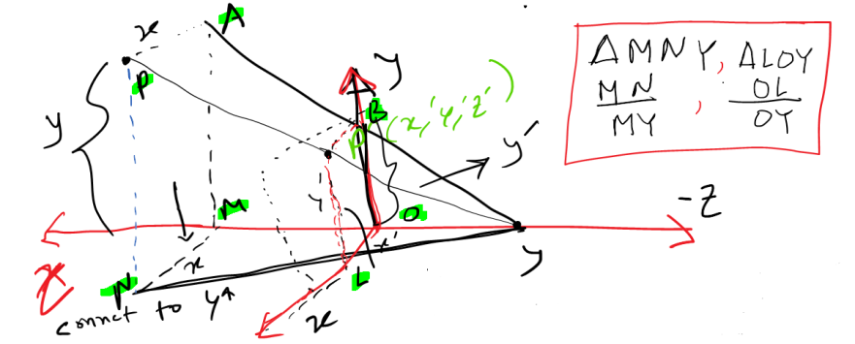
Parspective Projection
Need to Find out Xʹ, Yʹ

Slide 12
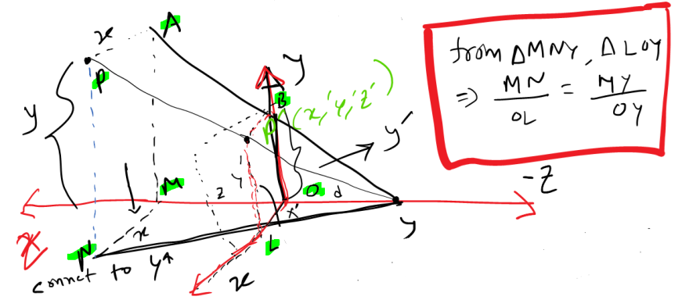
Parspective Projection
Need to Find out Xʹ, Yʹ

Slide 13
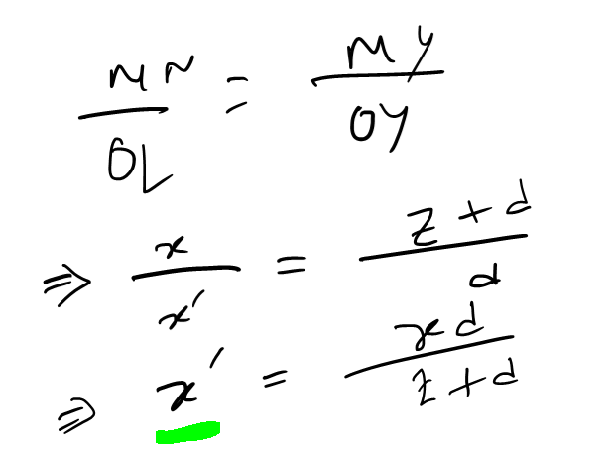
Parspective Projection
Value of Xʹ

Slide 14
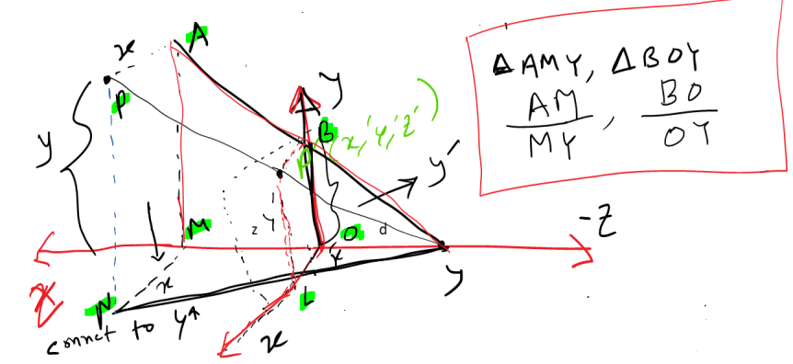
Parspective Projection
Find Value of Yʹ

Slide 15
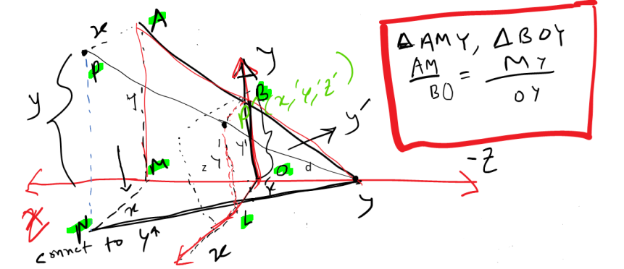
Parspective Projection
Find Value of Yʹ

Slide 16
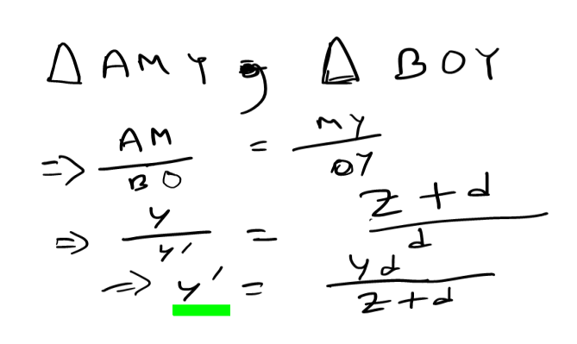
Parspective Projection
Value of Yʹ

Slide 17
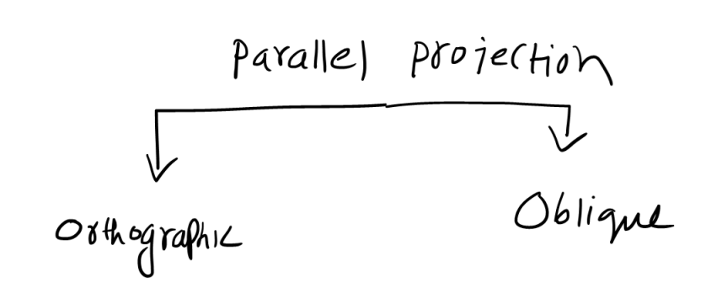
Parallel Projection
Parallel Projection

Slide 18
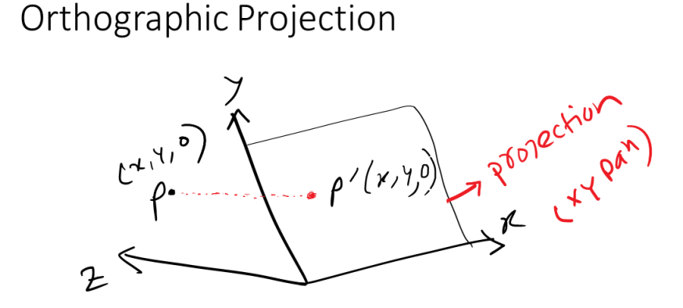
Orthographic Parallel Projection
Orthographic Projection

Slide 19
Orthographic Parallel Projection
Orthographic Projection

Slide 20
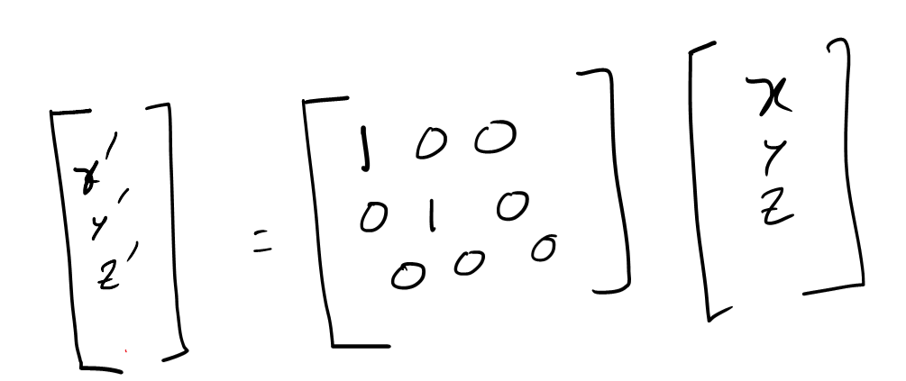
Parallel Projection
Orthographic Projection (In Matrix)

Slide 21
Parallel Projection
Orthographic Projection (In Matrix)

Slide 22
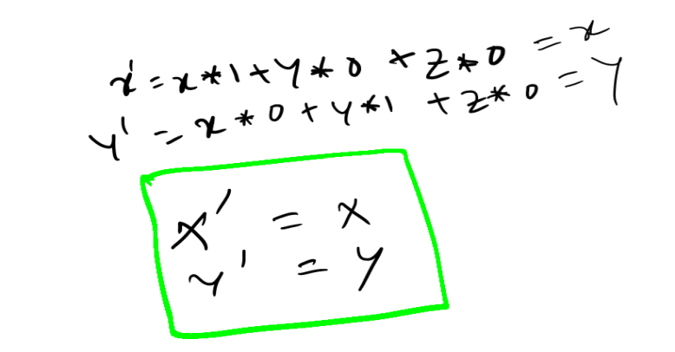
Orthographic Parallel Projection
Orthographic Projection : Xʹ, Yʹ

Slide 23
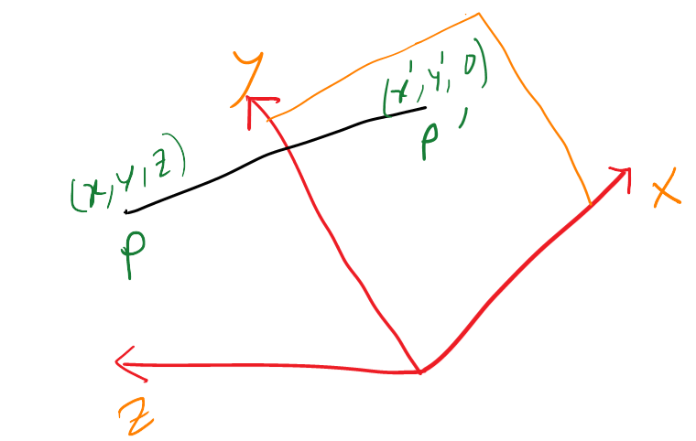
Oblique Parallel Projection
Find (Derivation): Xʹ, Yʹ

Slide 24
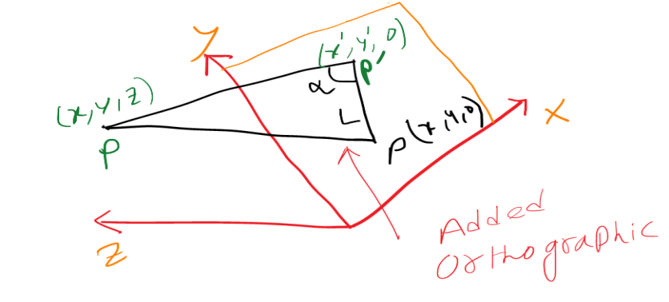
Oblique Parallel Projection
Find (Derivation): Xʹ, Yʹ

Slide 25
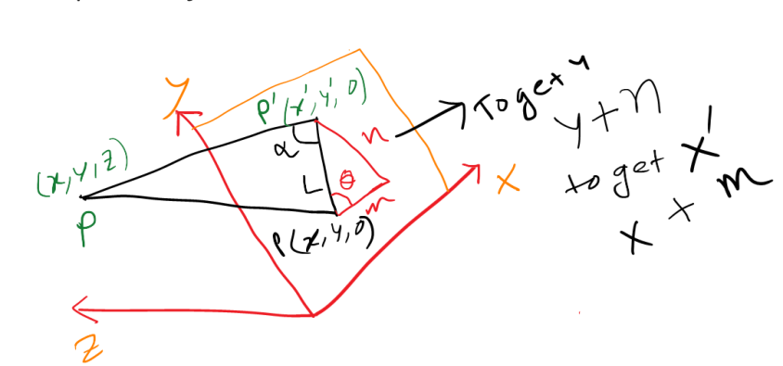
Oblique Parallel Projection
Find (Derivation): Xʹ, Yʹ

Slide 26
Oblique Parallel Projection
Find (Derivation): Xʹ, Yʹ

Slide 27
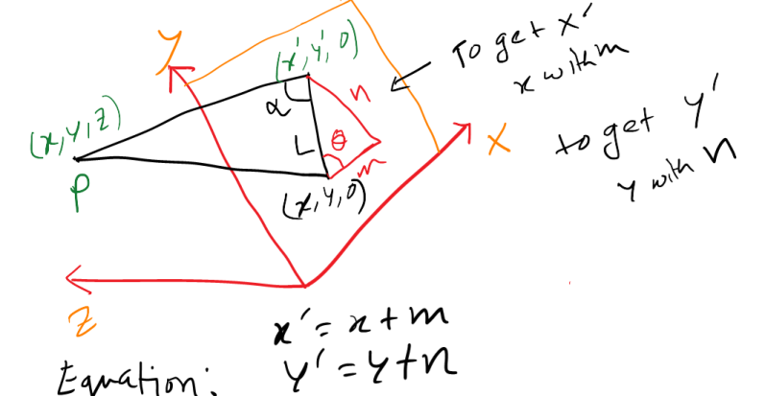
Oblique Parallel Projection
Find (Derivation): Xʹ, Yʹ

Slide 28
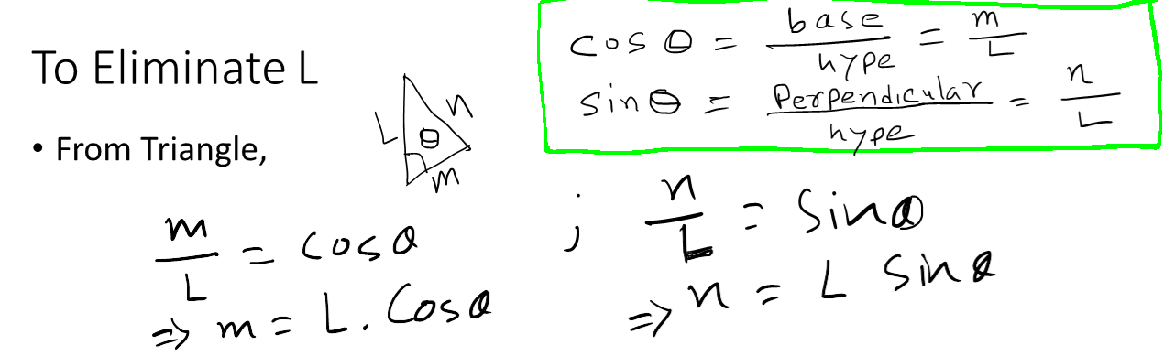
Oblique Parallel Projection
Find (Derivation): Xʹ, Yʹ

Slide 29
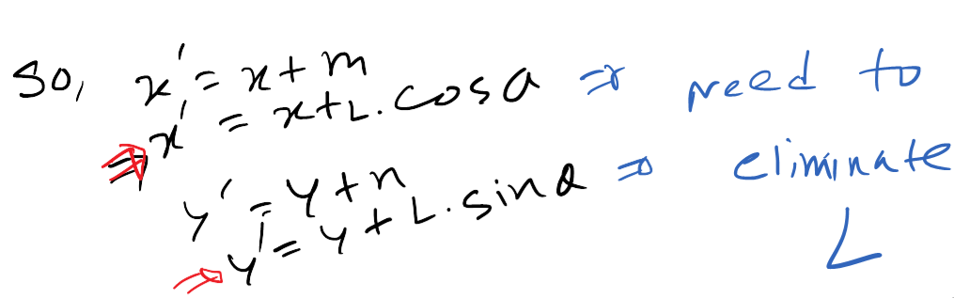
Oblique Parallel Projection
Find (Derivation): Xʹ, Yʹ

Slide 30
Oblique Parallel Projection
Find (Derivation): Xʹ, Yʹ

Slide 31
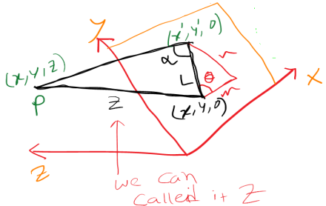
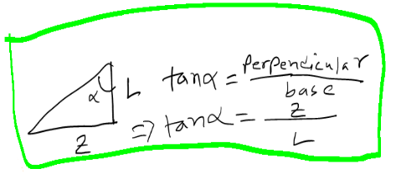
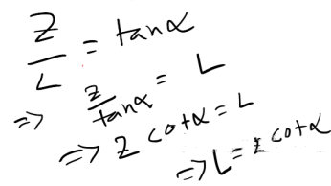
Oblique Parallel Projection
Find (Derivation): Xʹ, Yʹ

Slide 32
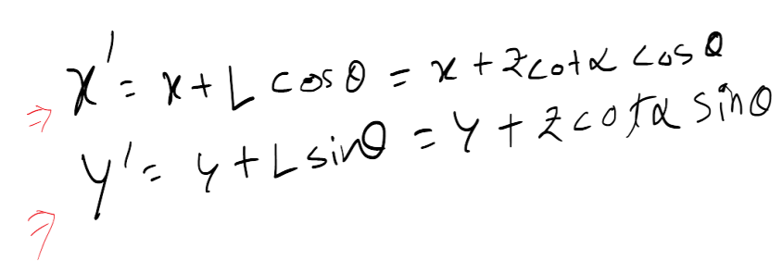
Oblique Parallel Projection
Find (Derivation): Xʹ, Yʹ

Slide 33
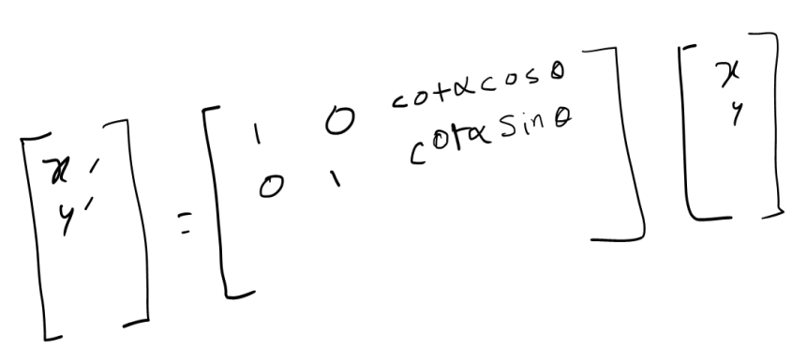
Oblique Parallel Projection
Find (Derivation): Xʹ, Yʹ

Slide 34
Books
Foley, van Dam, Feiner, Hughes, Computer Graphics: principles and practice, Addison Wesley, Second Edition.
Schaum's Outline of Theory & Problems of Computer Graphics.
Peter Shirley Steve Marschner , “Fundamental of computer graphics”, Third Edition.

Slide 35
References
Chapter 6: Basic Raster Graphics Algorithm for Drawing 2D Primitives.
Foley, van Dam, Feiner, Hughes, Computer Graphics: principles and practice, 2nd ed.
https://en.wikipedia.org/wiki/3D_projection
https://www.slideshare.net/SanuPhilip/projection-in-computer-graphics

